Slide 1


Slide 2

Introducing Microsoft Azure Big Data Platform https://git.io/vrwyo
Francesco Scullino

Slide 3
Agenda:
Big Data overview
Hadoop
Azure HDInsight
Demo
Hands-on Lab

Slide 4
Big Data overview

Slide 5
What is Big Data?
Many definitions:
Big data is high volume, high velocity, and/or high variety information assets that require new forms of processing to enable enhanced decision making, insight discovery and process optimization Gartner 2012
….
Big Data happens when the data you have to process is bigger than what you can process in the given time with current technologies Silicon Angle
Big Data is often described using 3/4/5 V

Slide 6

Volume
Refer to the large amount of data to be stored and analyzed
Traditional storage have upper memory limits

Slide 7

Velocity
Refer to the speed at which new data are generated shared
It needs technologies to analyze data in near real time or real time

Slide 8

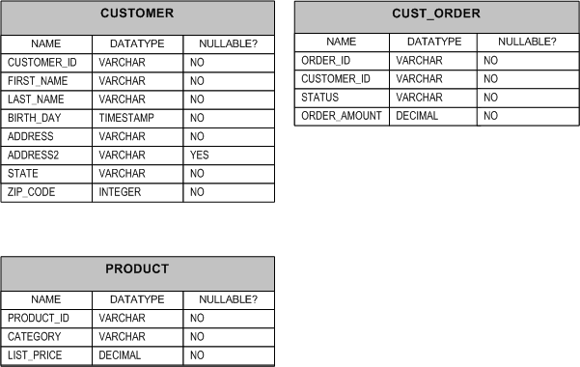


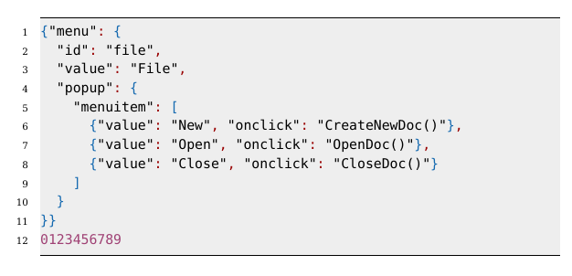
Variety
Refer to the different types of data we can process
Structured
Semi-structured
Unstructured

Slide 9
... and
[Veracity]: refer to the quality of the data
[Value]: refer to the business decisions that can be taken at the end of big data processing

Slide 10
Data sources
Conversations
Social Media
Application logs
Photos
Videos
Text
...

Slide 11
Value
Understand and target customers analyzing web search trends
Disaster management analyzing social media
Improve security analyzing conversation
Internet of things: store and analyze data coming from a sensor network
...

Slide 12
How do big data solutions work?
Big data batch breaks up source data files into multiple blocks and replicates the blocks on a distributed cluster of nodes (servers). Data processing runs in parallel on each node, and the parallel processes are then combined into an aggregated result set.

Slide 13
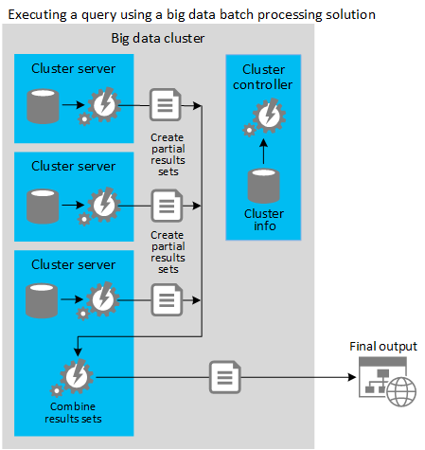
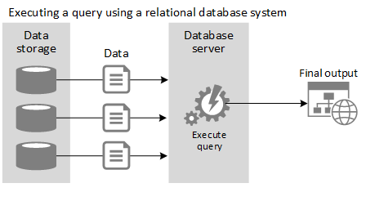
RDBMS Query vs Big Data Processing

Slide 14
Hadoop

Slide 15
Hadoop
At the core of many big data implementations is an open source framework named Apache Hadoop
Core modules
HDFS
MapReduce: framework to compute distributed processing using Java language
Common utilities
YARN: job scheduler and cluster manager

Slide 16
HDFS data distrubution
1
Node 1
Node 2
Node 3
Node 4
Node 5
2
2
1
1
2
1
3
4
3
2
3
3
4
5
4
5
5
4
5
Input file

Slide 17
Hadoop MapReduce
Programming framework (library and runtime) for analyzing datasets stored in HDFS
Composed of user-supplied Map and Reduce functions:
Map() - subdivide and conquer
Reduce() - combine and reduce cardinality
1. Divide a large problem into sub-problems.
………
Map()
2. Perform the same function on all sub-problems.
Do work()
Do work()
Do work()
3. Combine the output from all sub-functions.
Reduce()
Output
Notes:
Talk Track: Let’s go over the main concepts for MapReduce. Hadoop MapReduce is a programming and runtime framework for analyzing datasets stored in HDFS. It’s designed to let you write applications that rapidly process vast amounts of data in parallel on a large cluster of compute nodes.
MapReduce jobs are composed of user-supplied Map and Reduce functions. Map functions take a divide and conquer approach to processing data as fast as possible. Reduce functions combine and reduce cardinality. The MapReduce framework provides all the “glue” and coordinates the execution of the Map and Reduce jobs on the cluster.
Map functions take a large problem and divide it into sub-problems and perform the same function on all sub-problems. Reduce functions perform the Combine process, which takes the output from all sub-problems and creates a result set out of it. Often this output is in the form of a delimited text file that can be easily consumed by the speed and serving layers.
Key Points:
Map: Subdivide tasks into smaller sub-tasks, and sends across various reducers
Reduce: Combine the sub-tasks and reduce cardinality
References:
Using MapReduce with HDInsight: http://www.windowsazure.com/en-us/manage/services/hdinsight/using-mapreduce-with-hdinsight/

Slide 18
MapReduce program
Twinkle, twinkle, little star
How I wonder what you are
Up above the world so high
Like a diamond in the sky
Programs = Sequence of “map” and “reduce” tasks.
Process large volumes of data in parallel
Divides the work into independent tasks across a large number of computers
Map
Map
Map
Map
twinkle 2
little 1
star 1
how 1
I 1
wonder 1
what 1
you 1
are 1
up 1
above 1
the 1
world 1
so 1
high 1
like 1
a 1
diamond 1
in 1
the 1
sky 1
Shuffle/Sort
Reduce
Reduce
twinkle 2
how 1
I 1
the 2
…
little 1
star 1
wonder 1
you 2
…

Slide 19
Hadoop
Other tools
Ambari: A web-based tool for provisioning, managing, and monitoring Apache Hadoop clusters
HBase: NoSQL column family database for large tables
Hive: A data warehouse infrastructure that provides data summarization and ad hoc querying
Mahout: A scalable machine learning and data mining library
Pig: A high-level data-flow language and execution framework for parallel computation
Storm: distributed real time computation system for processing large stream of data
Spark: process data in memory
…

Slide 20
Azure HDInsight

Slide 21
Hadoop on Azure = HDInsight
Windows (Hortonworks Data Platform) and Linux clusters
Supports customization through RDP/SSH and/or Script Action
Install additional components like Spark, R, Kafka, Solr, Girafe or customize settings
Languages: Java, C#, Python, F#
Separate Compute from Storage
Azure Blob Storage in lieu of traditional HDFS

Slide 22


HDInsight Storage Infrastructure
Stream data
to compute
Push data
back to storage
Azure Blob Storage
Azure Flat Network Storage
map
sort
shuffle
reduce
HDInsight Compute Nodes (Large VMs)
Notes:
Hdinsight streams data to compute node
Many of the operations are done locally on compute node
Shuffle tasks will use some network to move less mapped data to reducers
Final step is moving the smallest amount of data back to the storage
In other words - network is heavily used in first phase for streaming
Common queries are smaller data sets and are streaming smaller amounts of data to each individual node
WASB provides faster write performance
The access methods are the same so you can specify file split size on either to maximize mapper progress and scale
No data durability SLA for local HDFS storage but Azure blob storage does!
Aggregate backplane of 50TBps for each azure datacenter

Slide 23
Demo: Wordcount using Java MapReduce https://git.io/vr29x

Slide 24
Refining Data in Hadoop

Slide 25


Data Preparation with Hive & Pig
Create structure over files
Process and refine data with SQL syntax
Generates/runs MapReduce
“Data Warehouse” focused
Process & shape data
Scripting language for ETL/ELT
Generates/runs MapReduce

Slide 26
Apache Hive
Project structure onto data
Schema on Read
Query data using a SQL-like language called HiveQL
SQL–Like Interface
No Java Needed!
Ad-hoc queries via HiveQL (translate into MapReduce)
Connect to Microsoft BI and Excel via Hive ODBC

Slide 27



Hive Architecture
Hive
HiveQL
Metastore
ODBC
JDBC
Hive Web Interface (HWI)
Command Line Interface (CLI)
Thrift Server
Compiler, Optimizer, Executor
Hadoop
Head Node
Name Node
Data Nodes / Task Nodes
Notes:
Thrift server has client and server components for translation between ODBC and Hadoop MR. It provides and interface definition language for RPC
Hive/HiveQL is simple, easy for SQL pros to learn
Hive design principles
Scalable, extensible (via UDF, UDAF), fault tolerant, and loose coupling with file formats.
What Hive is not
Low latency response times on queries.
Data warehousing framework on Hadoop
Imposes metadata / familiar looking HiveQL
Simple translation layer for MapReduce
Extensible via custom mappers/reducers
Loose coupling with input formats
Enables analytics from high level BI tools via ODBC

Slide 28
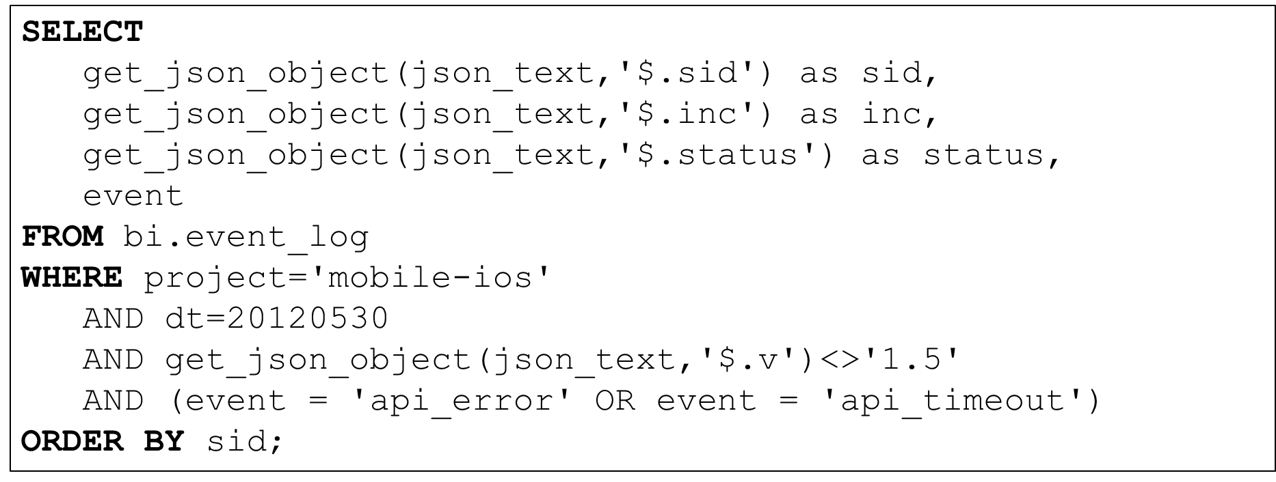
Hive
Metastore
Hive
Engine
MapReduce
HDFS

Slide 29
Data Preparation with Hive External and Internal Tables
CREATE EXTERNAL TABLE flights(…column definitions…)
fields terminated by ','
lines terminated by '\n'
stored as textfile
location ‘wasb://cluster.blob.core.windows.net/flights_raw';
Use EXTERNAL when
Data used outside Hive
You need data to be updatable in real time
Data needed when you drop the cluster or the table
Hive should not own data and control settings, dirs, etc.
Use INTERNAL when
You want Hive to manage the data and storage
Short term usage
Creating table based on existing table (AS SELECT)

Slide 30
Apache Pig
Apache Pig is a simple-to-understand data flow language used in the analysis of large data sets.
Load: Read data to be manipulated from the file system
Transform: Manipulate the data
Dump or store: Output data to the screen or store for processing
Scripting – No Java Needed!
Pig scripts are automatically converted into MapReduce jobs
Pig's language layer consists of a textual language called Pig Latin and a command shell Grunt

Slide 31


Sqoop
Data connector system for Hadoop and RDBMS
Importing RDBMS data to files (delimited or sequence) in HDFS, or tables in Hive
Importing RDBMS query results to files (delimited or sequence) in HDFS, or tables in Hive
Exporting files and Hive tables to RDBMS tables
Executes MapReduce jobs to transfer data in parallel with fault tolerance
Download: Microsoft SQL Server Connector for Apache Hadoop from http://www.microsoft.com/en-us/download/details.aspx?id=27584

Slide 32
Sqoop Import/Export
2. Submit Map-Only Job
2. Submit Map-Only Job
Sqoop Import
Hadoop
Sqoop Export
Hadoop
Sqoop job
HDFS Storage
Sqoop job
HDFS Storage
Map
Map
1. Gather Metadata
1. Gather Metadata
Map
Map
RDBMS
RDBMS
Map
Map
Map
Map
https://blogs.apache.org/sqoop/entry/apache_sqoop_overview

Slide 33
Demo: Hive https://git.io/vrray

Slide 34
Hands-On Lab https://git.io/vrraF

Slide 35
Online resources
Microsoft Azure: azure.microsoft.com
Free online training at Microsoft Virtual Academy: microsoftvirtualacademy.com
Lots of stuff: github.com/Azure-Readiness

Slide 36
Q&A
Francesco Scullino
scullino@ismb.it
v-frscul@microsoft.com

